Slide 1
INFOSYS SPRINGBOARD VIRTUAL INTERNSHIP 7.0 · BATCH 3 · DATA VISUALIZATION
EduVision_DV
Higher Education Intelligence System for Institutional Performance & Academic Excellence Analysis
An executive business intelligence suite integrating QS World University Rankings 2025 and Times Higher Education (THE) datasets across four interactive Tableau Desktop dashboards.
1,503
Institutions
106
Countries
195
Matched Cohort
6
Core KPIs
4
Dashboards
24
Worksheets
Project Contributor: Kurapalli Sharmila · Domain: Higher Education Analytics & Visual BI · Tableau Desktop 2026.2

Slide 2
CONTEXT & CHALLENGES
Problem Statement: Fragmented Higher Education Intelligence
Higher education ranking data is distributed across incompatible league tables, preventing unified strategic decision-making.
INDUSTRY CHALLENGE
Diagnostic Overview
The Higher Education Visibility Gap
• 1,503 institutions across 106 nations require cohesive decision intelligence, yet fragmented ranking systems obscure institutional truth.
• Academic leadership, national ministries, and prospective students cannot cross-evaluate teaching capacity, research impact, and reputation from single league tables.
• EduVision_DV addresses this structural void by creating an integrated, mathematically normalized business intelligence system.
01
Data Scattered Across Competing Systems
QS and Times Higher Education (THE) maintain fundamentally disparate schemas, evaluation scopes, and coverage universes.
02
Incompatible Ranking Indicators
Contrasting indicator weightings, differing scale ranges, and non-numeric rank strings ('15=', '1401+') prevent mathematical joins.
03
Siloed Research & Student Analytics
Institutional pillars—student-staff ratios, international diversity, and citation velocity—are evaluated in isolation without unified correlation.
04
Raw League Tables Lack Executive BI
Static PDF/web tables offer zero dynamic cross-filtering, regional benchmarking, or drill-down visual exploration for decision-makers.

Slide 3
MISSION & SCOPE
Project Objectives: End-to-End Business Intelligence
Transform raw global ranking datasets into a verified, interactive executive decision-support analytics suite.
PROJECT MANDATE
Strategic Objective
Core Project Vision
• Establish an authoritative higher education intelligence architecture bridging disparate international ranking systems.
• Replace static league tables with interactive, four-dimensional business intelligence spanning institutional overviews, research depth, student experiences, and national footprints.
• Ensure 100% data reproducibility through automated Python pipelines and rigorous testing frameworks.
OBJECTIVE 01
Integrate QS & THE Ranking Authorities
Ingest 1,503 institutions across 106 countries from QS 2025 and enrich top-tier universities with Times Higher Education metrics while enforcing strict schema hygiene and Latin-1 encoding correction.
OBJECTIVE 02
Engineer 6 Standardized Academic KPIs
Formulate and statistically validate 6 standardized higher education KPIs covering global ranks, academic reputation, citations per faculty, staffing ratios, student diversity, and research proxy.
OBJECTIVE 03
Architect 4 Interactive Tableau Dashboards
Build four interconnected Tableau Desktop dashboards (fixed 1600 × 950 canvas) across 24 modular worksheets featuring interactive cross-filtering, choropleth maps, and rank movement tracking.

Slide 4
DATA FOUNDATION
Data Sources & Project Scope: Two Global Authorities, One Master Table
Harmonizing the world's most prestigious university ranking systems into a single verified master datastore.
PRIMARY UNIVERSE
Base Table: QS World University Rankings 2025
• Scope: 1,503 institutions across 106 global countries.
• Dimensions: 28 raw dimensions including ranks, overall scores, reputation scores, citations per faculty, region, size, and focus.
• Preserved Universe: 100% of QS institutions retained as the master base table without dropping unranked rows.
• Scored Subset: Overall scores published for top 600 institutions (range: 20.8 - 100.0, mean: 41.84).
ENRICHMENT UNIVERSE
Enrichment: Times Higher Education (THE) Data
• Scope: 200 elite institutions across 29 jurisdictions.
• Dimensions: 13 attributes including students-per-staff ratio, international student %, FTE student enrollment, and research environment.
• Integration: Left join against QS based on standardized institution identity with 30 reviewed alias mappings.
• Matching Exceptions: 5 THE institutions were intentionally left unmatched because they were either absent from the QS universe or represented ambiguous multi-campus systems.
GOVERNED MISSINGNESS
Integrated Dataset Scope & Governed Missingness Policy
• Master Schema: Exactly 1,503 institutions, 106 countries, and 52 final dimensions.
• Match Outcome: 195 institutions successfully matched (97.5% of THE top 200). Exactly 1,308 unmatched institutions retain explicit nulls.
• Analytical Honesty: THE-related nulls reflect source-coverage boundaries, NOT data errors. Zero synthetic imputation was applied.

Slide 5
TOOLS & FRAMEWORKS
Technology Stack: Verified Production Tools & Libraries
Every technology in the pipeline was selected for reproducibility, analytical rigor, and visual performance.
DATA PROCESSING & ETL
Python, Pandas & NumPy
• Python 3.10+ runtime
• Pandas for tabular transforms
• NumPy for array & rank operations
• OpenPyXL for Excel exports
• Automated pipeline execution
• Latin-1 encoding hygiene
• Rank midpoint continuous parsing
• 30-alias entity resolution engine
EXPLORATION & NOTEBOOKS
Jupyter & Google Colab
• Jupyter Notebook environment
• Google Colab cloud execution
• Matplotlib & Seaborn EDA
• Milestone 1 cleaning notebook (14 cells)
• Milestone 2 KPI notebook (18 cells)
• Byte-identical dual-pipeline run
• Verified MD5 checksum equality
• Full analytical reproducibility
VISUAL ANALYTICS BI
Tableau Desktop & Public
• Tableau Desktop 2026.2 (Apple Silicon)
• Tableau Public cloud deployments
• Fixed 1600 × 950 canvas design
• Exactly 24 modular worksheets
• 12 custom calculated fields
• Custom dark theme (#12161A)
• Cross-dashboard filter actions
• Native Hyper packaged extract
STORAGE, QA & CONTROL
Excel, CSV & Git/GitHub
• Microsoft Excel (.xlsx) styled tables
• Flat CSV master dataset
• Git version control with branches
• GitHub submission repository
• 36 automated Python assertions
• 62-point comprehensive QA audit
• Clean 5-folder milestone layout
• Zero temporary build artifacts

Slide 6
PIPELINE ARCHITECTURE
Methodology & Workflow: Step-by-Step Analytical Pipeline
A structured, eight-stage data engineering and visual analytics process ensuring complete reproducibility.
STEP 01
1. Data Collection
Ingest raw QS (1,503 rows) and THE (200 rows) with Latin-1 verification.
STEP 02
2. Data Cleaning
Parse rank strings ('15=', '1401+'), normalize 29 national jurisdictions.
STEP 03
3. Standardization
Standardize university identities; map 30 known alias variations.
STEP 04
4. Integration
Execute left join on standardized keys; preserve 100% of QS universe.
STEP 05
5. KPI Engineering
Derive 6 core indicators; formulate 3 tooltip display helper fields.
STEP 06
6. Data Validation
Execute 36 automated assertions; verify dual-pipeline MD5 hash.
STEP 07
7. Tableau BI Build
Develop 4 dashboards across 24 worksheets with interactive filter actions.
STEP 08
8. Testing & Docs
Complete 62-point QA checklist, resolve 10 UI defects, deliver documentation.

Slide 7
PERFORMANCE METRICS
Six KPI Framework: Engineered Higher Education Metrics
Standardized indicators evaluating institutional excellence across teaching, research impact, and reputation.
KPI 01
Global Ranking Score
• Source: QS Overall Score (Direct mapping)
• Coverage: Top 600 ranked institutions
• Statistical Mean: 41.84 (Range: 20.8 – 100.0)
• Purpose: Composite institutional benchmark
KPI 02
Academic Reputation Score
• Source: QS Academic Reputation (Direct mapping)
• Coverage: All 1,503 institutions (100%)
• Statistical Mean: 20.29 (Range: 1.3 – 100.0)
• Purpose: Global peer survey standing
KPI 03
Faculty-to-Student Ratio
• Source: THE No. of Students per Staff (Direct mapping)
• Coverage: 195 matched institutions
• Statistical Mean: 17.44 (Range: 3.8 – 58.0)
• Purpose: Teaching capacity & workload
KPI 04
International Student Percentage
• Source: THE International Students (%)
• Coverage: 195 matched institutions
• Statistical Mean: 25.48% (Range: 1.0% – 72.0%)
• Purpose: Campus diversity & global attraction
KPI 05
Research Impact Score
• Source: QS Citations per Faculty (Direct mapping)
• Coverage: All 1,503 institutions (100%)
• Statistical Mean: 23.50 (Range: 1.0 – 100.0)
• Purpose: Size-adjusted citation velocity
KPI 06
Research Productivity (Proxy)
• Source: THE Research Environment score
• Coverage: 195 matched institutions
• Statistical Mean: 61.23 (Range: 34.9 – 100.0)
• Note: Derived from THE Research Environment and is NOT an official THE metric.
Methodological Disclosure: Research Productivity (Proxy) is derived strictly from THE Research Environment and is NOT an official THE metric.

Slide 8
DATA HYGIENE & QUALITY
Data Validation & Integration: Verified Coverage & Integrity
Rigorous audit confirms high source completeness, zero synthetic imputation, and governed null preservation.
DATA COMPLETENESS AUDIT
99.02%
QS Base Fields Completeness
(Excluding Overall Score; 0.98% missing)
96.98%
QS Base Fields Completeness
(Including Overall Score; exceeds 95% threshold)
100.0%
THE Cleaned Completeness
(All 200 elite institutions intact)
0.0%
Synthetic Imputation
(Zero unranked rows artificially fabricated)
COHORT SCALE
Verified Cohort Dimensions & Universe Breakdown
• 1,503 Total Institutions: 100% of the QS World University Rankings 2025 base table preserved.
• 106 Countries Covered: Complete geographic distribution across all global territories.
• 195 QS–THE Matched Institutions: 97.5% match rate against the THE top 200 universe.
• 1,308 Unmatched QS Institutions: Explicitly retained with legitimate nulls for THE attributes.
• 52 Final Master Columns: Encompassing ranks, raw indicators, engineered KPIs, and display strings.
ANALYTICAL HONESTY
Source-Coverage Limitations vs Data Errors
• Governed Missingness: The 1,308 institutions without THE data reflect the inherent coverage boundary of THE's published top-200 league table, NOT data ingestion errors.
• Analytical Honesty: Preserving true blanks eliminates synthetic bias in university benchmarks and ensures that all institutional comparisons remain statistically genuine.
• Dual-Pipeline Verification: Standalone Python CLI scripts and Google Colab notebook produce byte-identical dataset exports (MD5 hash verified).

Slide 9
VISUAL ARCHITECTURE
Dashboard Suite Overview: Four Interconnected Executive Views
An integrated business intelligence system providing progressive drill-downs from global macro analysis to university deep-dives.
MACRO DIRECTORY
Dashboard 1: University Overview
• Level: Macro institutional directory & temporal rank movement.
• Core Visuals: Top Ranked Uni KPI, Total Unis (1,503), Avg Global Score (41.84), Top 10 Bar Chart, Regional Donut, World Map, Rank Movement 2024–2025.
• Analytical Value: Immediate institutional benchmarking and year-over-year rank trajectory tracking.
RESEARCH EXCELLENCE
Dashboard 2: Research Analytics
• Level: Specialized research excellence & productivity analysis.
• Core Visuals: Highest Research Impact KPI (100.0), Avg Citations (23.50), Avg Research Productivity Proxy (61.23), Scatter Plot, Box Plots, Top 10 Paired Bars.
• Analytical Value: Unpacks citation velocity vs publishing environment across research intensity tiers.
ENVIRONMENT & DIVERSITY
Dashboard 3: Student Analytics
• Level: Learning environment, student body scale & global diversity.
• Core Visuals: Avg Students per Staff KPI (17.4), Avg International % (25.5%), Total Headcount (5.46M), Regional Staffing Ratios, Scatter Plot, Top 10 Enrollment.
• Analytical Value: Evaluates teaching resourcing and campus internationalization across 195 matched universities.
NATIONAL BENCHMARKING
Dashboard 4: Country Comparison
• Level: Territorial benchmarking connecting national tables to world maps.
• Core Visuals: Top Country by Avg Score KPI (Hong Kong SAR 79.9), 106 Nations, USA Dominance (197 unis), Benchmarking Heat Table, World Choropleth Map.
• Analytical Value: Features interactive cross-filtering connecting benchmarking heat table directly to world map.

Slide 10
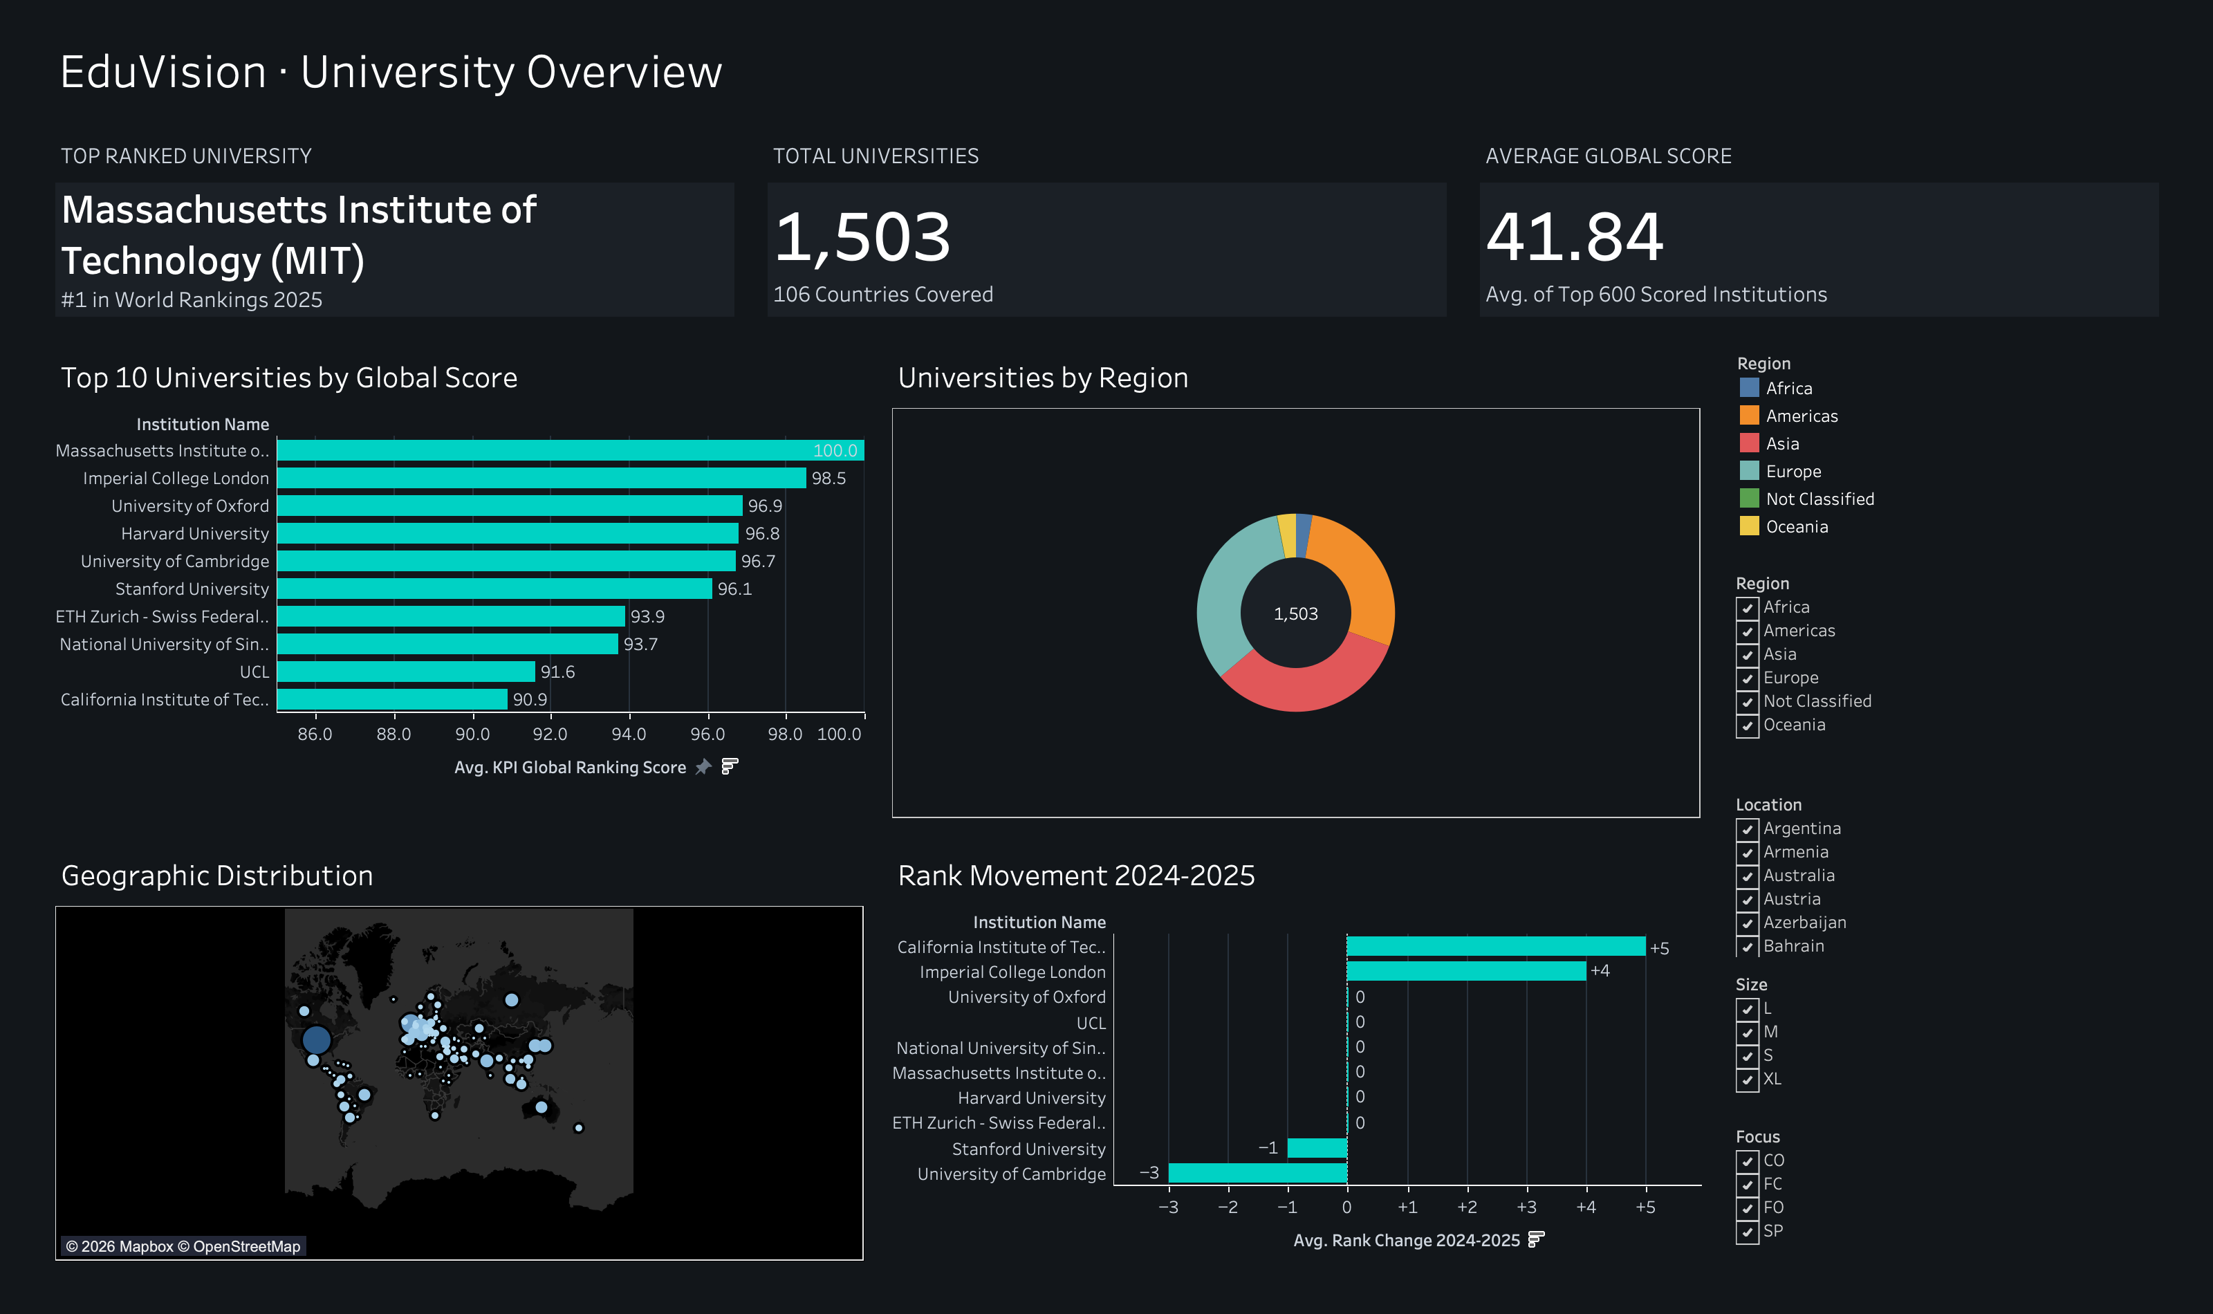
TABLEAU DASHBOARD 1 OF 4
Dashboard 1: University Overview & Rank Movement
Comprehensive institutional directory and temporal performance shift analysis.
DASHBOARD FEATURES
Executive Capabilities
Key Visualizations & Features
• Dynamic KPI Cards: Top Ranked University (MIT #1), Total Universities (1,503), Dynamic Average Score (41.84).
• Top 10 by Global Score: Horizontal bar chart with axis framed 85–100 to clearly separate elite scores.
• Regional Distribution Donut: Dual-axis donut highlighting European (473) and Asian (511) dominance.
• Global Geographic Map: World map plotting global institutional footprint across 106 countries.
• Rank Movement 2024–2025: Calculated as Rank Change = RANK_2024 - RANK_2025. Positive = improvement, Negative = decline. Caltech +5, Imperial +4, Cambridge -3, Stanford -1, 6 unchanged.

Slide 11
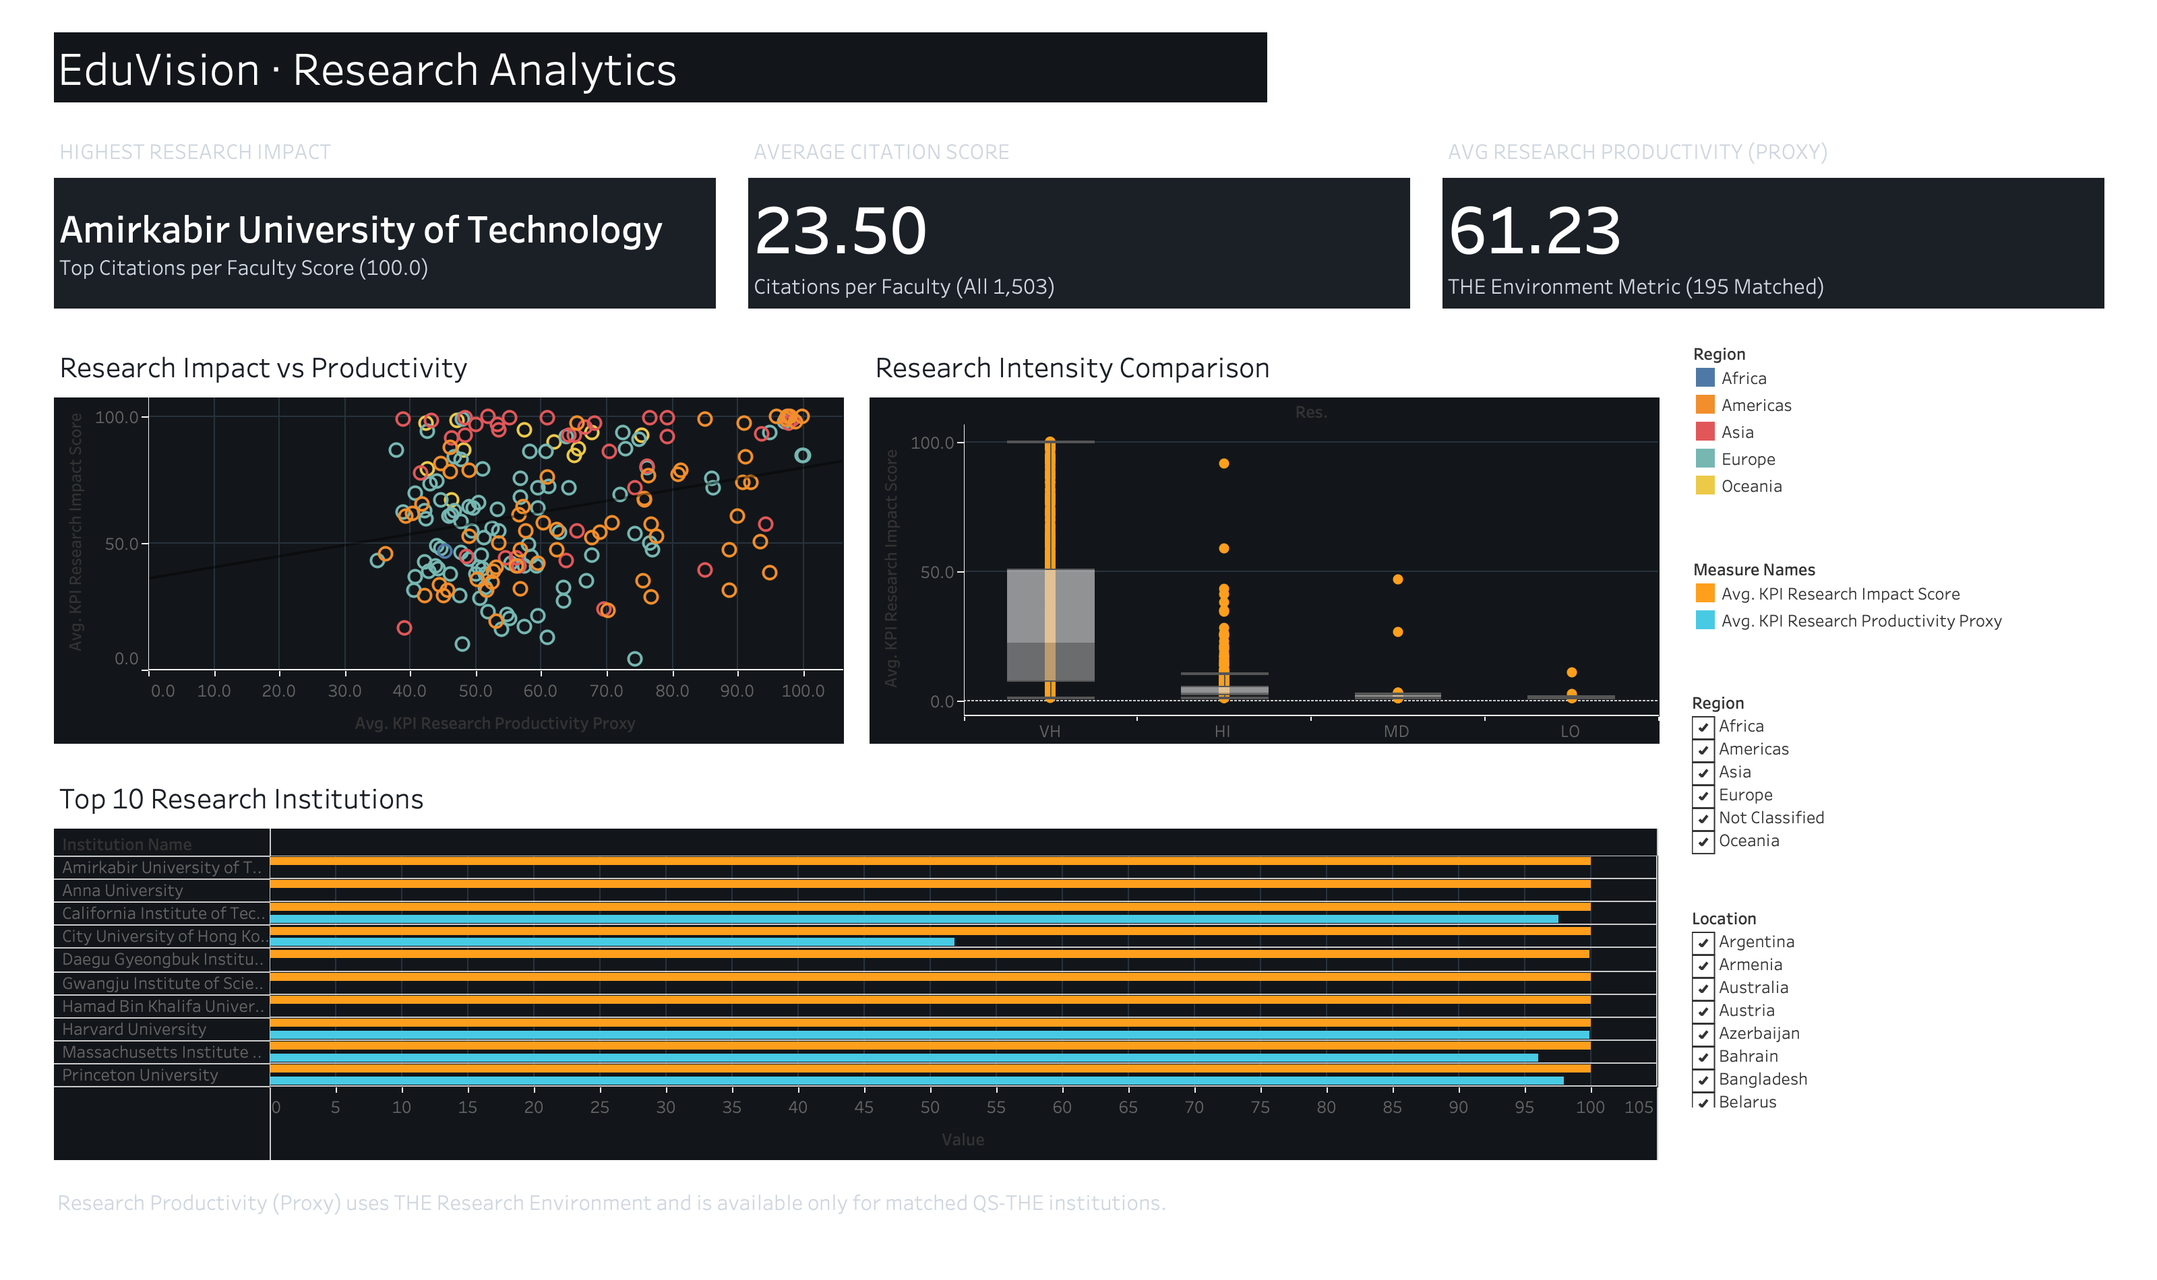
TABLEAU DASHBOARD 2 OF 4
Dashboard 2: Research Analytics — Impact & Productivity
Evaluating institutional citation velocity against research environment depth.
DASHBOARD FEATURES
Research Intelligence
Key Visualizations & Features
• Research KPI Cards: Highest Research Impact (100.0), Avg Citations per Faculty (23.50), Avg Research Productivity Proxy (61.23).
• Impact vs Productivity Scatter: Weak correlation demonstrates that publication volume environment does not guarantee citation impact.
• Research Intensity Box Plots: Significant citation variance observed across Very High (1,021) down to Low (16).
• Top 10 Research Institutions: Paired bars showing citation impact alongside productivity proxy score.
• Proxy Disclosure: Research Productivity (Proxy) is derived from THE Research Environment and is NOT an official THE metric.
• Publication-Volume Note: Publication-volume analysis was not implemented because the available QS/THE source data does not provide a directly comparable publication-count field.

Slide 12
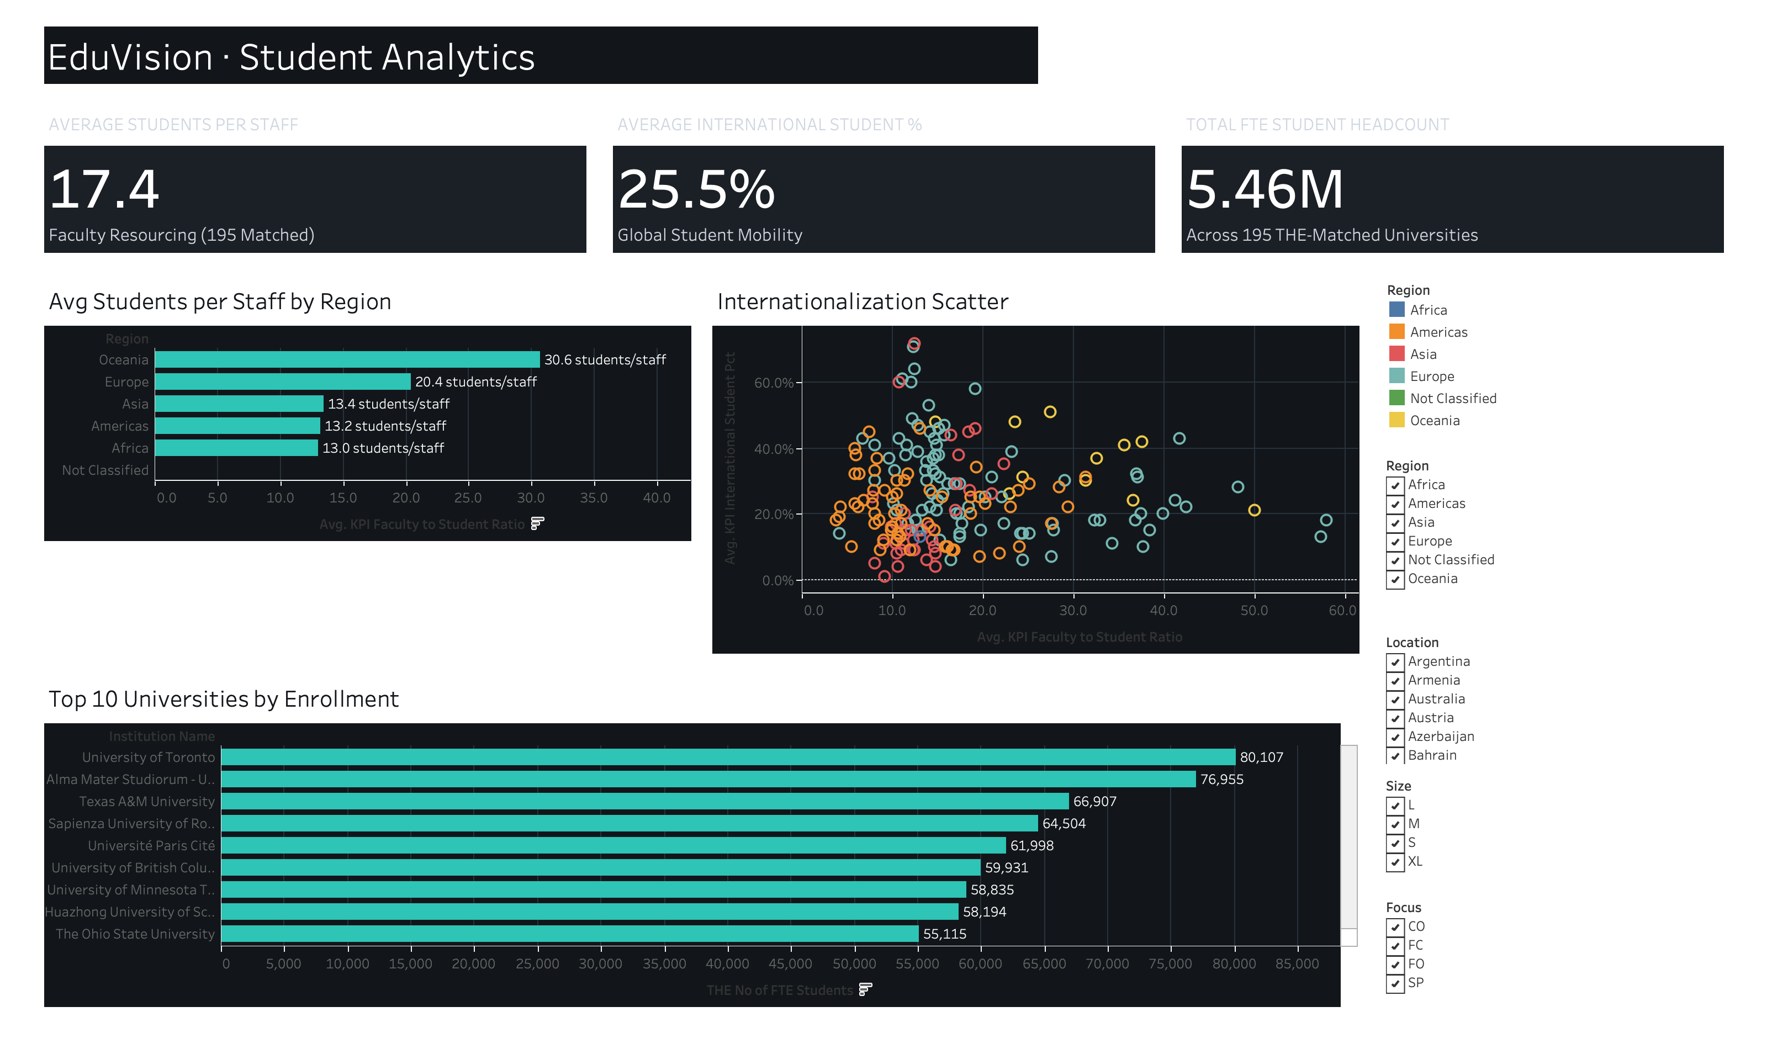
TABLEAU DASHBOARD 3 OF 4
Dashboard 3: Student Analytics — Ratios & Diversity
Analyzing teaching workloads, campus internationalization, and total student enrollment.
DASHBOARD FEATURES
Environment & Capacity
Key Visualizations & Features
• Student KPI Cards: Avg Students per Staff (17.4), Avg International Student % (25.5%), Total FTE Student Headcount (5.46M across 195).
• Regional Staffing Ratios: Average students per staff by region reveals massive divergence (Oceania 30.6 vs Africa 13.0).
• Internationalization Scatter: Evaluates international student percentage against student-to-staff workload.
• Top 10 by Enrollment: University of Toronto leads at 80,107 FTE students, followed by University of Bologna (76,955).
• Interactive Cohort Benchmarking: Multi-dimensional filters (Region, Location, Size, Focus) allow dynamic cohort comparison.

Slide 13
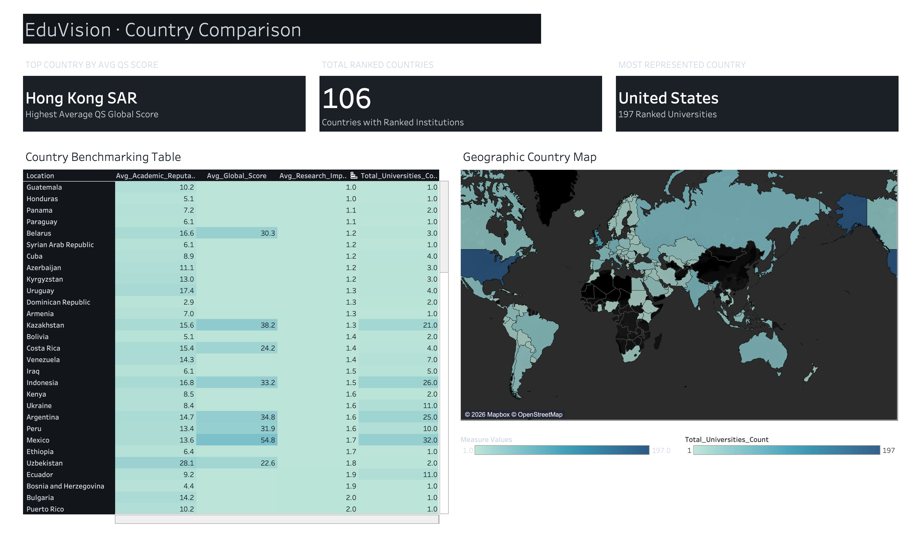
TABLEAU DASHBOARD 4 OF 4
Dashboard 4: Country Comparison & Cross-Filtering
Macro-level territorial benchmarking connecting national heat tables to global choropleth maps.
DASHBOARD FEATURES
National Benchmarking
Key Visualizations & Features
• Country KPI Cards: Top Country by Avg Score (Hong Kong SAR, 79.9), Most Represented (United States, 197 unis), Total Ranked Countries (106).
• Benchmarking Heat Table: Comprehensive evaluation of all 106 countries across institutions, scores, reputation, and citations.
• Geographic Choropleth Map: Global gradient of national institutional representation.
• Interactive Filter Action: Selecting a country in the benchmarking table filters the geographic map; clearing the selection restores all countries.
• Top-N Reference Stability: Global reference cards remain stable without dropping out during cross-filtering.

Slide 14
ANALYTICAL INSIGHTS
Key Findings & Insights: Educational Intelligence from Verified Data
Concrete empirical observations derived from the harmonized QS and THE higher education dataset.
INSIGHT 01
Peak Excellence vs System Depth
Hong Kong SAR achieves the highest average global score (79.9) across just 6 elite institutions. In contrast, the United States leads in sheer volume (197 institutions) with wider internal variance, demonstrating the difference between elite concentration and broad system depth.
INSIGHT 02
Productivity Decoupled from Citation Impact
High research environment scores do not automatically produce high citation impact. World-leading citations appear across varied productivity tiers, confirming that research quality and publishing environment represent distinct dimensions.
INSIGHT 03
Structural Regional Staffing Divergence
Teaching loads diverge radically by continent: Oceania averages 30.6 students per staff member, while Africa averages 13.0, reflecting fundamental differences in funding structures and massification models.
INSIGHT 04
Coverage Discipline Prevents Misleading BI
Only 2 of the 6 KPIs cover the entire 1,503-institution universe. Surface-level averaging without explicit population tags would have produced misleading claims about unmeasured universities. Explicit scoping preserves analytical truth.

Slide 15
TECHNICAL SOLUTIONS
Challenges & Solutions: Engineering Robust Analytics
Navigating complex data harmonization challenges with sound methodological resolutions.
RESOLUTION 01
Different Schemas Across QS & THE
Challenge: Disparate column schemas and differing indicator scales prevented immediate joins.
Solution: Standardized schemas with common dimension keys and mapped ranking indicators into unified types.
RESOLUTION 02
University-Name Mismatches
Challenge: Naming variations ('UC Berkeley' vs 'University of California, Berkeley') broke automated joins.
Solution: String normalization plus 30 reviewed manual alias mappings achieved a 97.5% match rate.
RESOLUTION 03
Partial THE Coverage (200 of 1,503)
Challenge: Standard tools often zero-fill or synthetically impute missing values, corrupting data integrity.
Solution: Governed missingness policy strictly preserving true nulls with zero synthetic imputation.
RESOLUTION 04
Missing Publication-Count Field
Challenge: Available source datasets lacked a direct comparable publication-count field.
Solution: Avoided fabricated publication metrics; evaluated research via Citations per Faculty & Research Environment proxy.

Slide 16
VERIFICATION & AUDIT
Testing & Validation: Conformance, Reproducibility & QA
Multi-tier quality assurance covering the data layer, calculations, interactive filters, and visual rendering.
DATA LAYER QA
36 Automated Data Assertions
• Boundary verification for all 6 KPIs.
• Exact non-null counts validated.
• Minimum and maximum bounds checked.
• Mathematical ranges (0-100, ratios) enforced.
• 100% of assertion tests passed.
• Zero data drift across exports.
PIPELINE QA
Dual-Pipeline Reproducibility
• Python CLI scripts run independently.
• Google Colab notebook run independently.
• Byte-identical CSV export verified.
• Byte-identical Excel export verified.
• MD5 checksum match confirmed.
• 100% computational reproducibility.
SYSTEM QA
62-Point QA & 24 Worksheets
• 62-point comprehensive QA checklist passed.
• Exactly 24 worksheets across 4 dashboards.
• 10 specific UI interaction defects fixed.
• Country filter action fully verified.
• Fixed 1600 × 950 canvas layout confirmed.
• Complete delivery documentation verified.

Slide 17
DEVELOPMENT JOURNEY
Project Milestones: Four Phases of Structured Delivery
A disciplined eight-week engineering journey delivering verified milestone artifacts.
MILESTONE 01
Milestone 1: Collection & Prep
Weeks 1–2 · Modules 1 & 2
• Ingested 1,703 raw records across QS and THE universes.
• QS cleaned dataset completeness: 96.87% — PASS (across all exported columns; base indicators achieve 96.98% / 99.02%).
• THE cleaned dataset completeness: 100.0%.
• Delivered data_collection.py, education_cleaning.ipynb, university_raw_data.csv, and university_cleaned.csv.
MILESTONE 02
Milestone 2: KPI Engineering
Weeks 3–4 · Modules 3 & 4
• Engineered 6 standardized higher education KPIs.
• Formulated 3 tooltip display calculations.
• 36 automated assertions passed with zero drift.
• Delivered generate_education_kpis.py, master CSV, master Excel, storyboard PDF, and prototype workbook.
MILESTONE 03
Milestone 3: Dashboard Development
Weeks 5–6 · Modules 5 & 6
• Built all 4 executive dashboards across exactly 24 worksheets.
• Integrated Rank Movement 2024–2025 on University Overview.
• Implemented interactive country-to-map filter actions.
• Delivered eduvision_dashboard_v1.twbx and 4 retina-ready screenshots.
MILESTONE 04
Milestone 4: Testing & Delivery
Weeks 7–8 · Modules 7 & 8
• Executed comprehensive 62-point QA checklist.
• Remediated 10 interaction defects logged during testing.
• Verified authoritative workbook MD5 checksum.
• Delivered QA_Checklist.md, Testing Report, methodology, and user guide.

Slide 18
SYSTEM ARCHITECTURE
Final System Architecture: End-to-End Pipeline & BI Suite
The unified flow from heterogeneous raw sources to an executive, decision-grade visual intelligence system.
LAYER 01 · INGESTION
Data Ingestion & Hygiene
• Source Ingestion: QS 2025 (1,503 rows, 28 fields) + THE 2024 (200 rows, 13 fields).
• Character Encoding: Strict Latin-1 decoding resolving special character glyphs.
• Rank Midpoint Parsing: Converted non-numeric rank bands ('15=', '1401+') to continuous floats.
• Geographic Alignment: Standardized 29 country and regional naming variations.
• Milestone 1 Deliverables: university_raw_data.csv, university_cleaned.csv, data_collection.py, education_cleaning.ipynb.
LAYER 02 · PROCESSING
Integration & KPI Engine
• Left-Join Integration: Unified master schema retaining 100% of QS universe (1,503 rows × 52 cols).
• Entity Resolution: 30 verified manual alias mappings yielding 97.5% match rate on THE top 200.
• Governed Missingness: Explicit nulls for 1,308 unmatched institutions (zero synthetic imputation).
• 6 Higher Education KPIs: Global Score, Reputation, Staffing Ratio, International %, Citations, Proxy.
• Master Datastore: Byte-identical exports to university_final_dataset.csv and .xlsx.
LAYER 03 · ANALYTICS
Tableau Visual BI Suite
• Tableau Engine: EduVision_DV.twbx Hyper packaged extract (MD5 verified).
• Modular Architecture: Exactly 24 worksheets across 4 executive dashboards (1600 × 950 canvas).
• Interactive Actions: Dashboard 4 country filter action connecting heat table and choropleth map.
• Executive Design: Midnight navy palette (#12161A), high contrast, built for strategic insight.
• Cloud Deployment: All 4 dashboards published live to Tableau Public with cloud interactivity.

Slide 19
PROJECT ROADMAP
Future Enhancements: Strategic Roadmap for Platform Scalability
Planned evolution to expand analytical depth, automation, and predictive modeling capabilities.
ENHANCEMENT 01
Multi-Ranking System Integration
Incorporate additional global league tables such as the Academic Ranking of World Universities (ARWU / Shanghai Ranking) and CWUR to build a multi-system consensus index.
ENHANCEMENT 02
Automated Data Refresh API Pipeline
Develop scheduled REST API connectors and scraping pipelines to automatically ingest newly released annual ranking editions without manual ETL intervention.
ENHANCEMENT 03
Multi-Year Longitudinal Time-Series
Ingest historical ranking editions from 2020 through 2025 to visualize multi-year institutional trajectories, momentum vectors, and rank volatility over time.
ENHANCEMENT 04
Predictive Machine Learning Analytics
Implement predictive regression and gradient boosting models to forecast next-cycle institutional ranks based on citation velocity, faculty hiring, and student ratios.

Slide 20
PROJECT DELIVERY
EduVision_DV: Final Submission & Live Tableau Public Suite
Interactive dashboards deployed on Tableau Public · Open floor for evaluation and technical inquiry.
LIVE DEPLOYMENTS
Tableau Public Interactive Dashboards
Dashboard 1: University Overview
https://public.tableau.com/app/profile/kurapalli.sharmila/viz/EduVision_DV_17913698181990/UniversityOverview
Dashboard 2: Research Analytics
https://public.tableau.com/app/profile/kurapalli.sharmila/viz/EduVision_DV_17913698181990/ResearchAnalytics
Dashboard 3: Student Analytics
https://public.tableau.com/app/profile/kurapalli.sharmila/viz/EduVision_DV_17913698181990/StudentAnalytics
Dashboard 4: Country Comparison
https://public.tableau.com/app/profile/kurapalli.sharmila/viz/EduVision_DV_17913698181990/CountryComparison
THANK YOU & Q&A
Project Submission & Evaluation
• Program: Infosys Springboard Virtual Internship 7.0 (Batch 3)
• Project: EduVision_DV
• Full Title: Higher Education Intelligence System
• Contributor: Kurapalli Sharmila
• Domain: Data Visualization & Analytics
• Technology: Tableau Desktop 2026.2 & Python 3.10+
• Authoritative Workbook: EduVision_DV.twbx (MD5: 133a10549295e4b3a1a2ab6640ae615d)
• Final Delivery: 5-Folder Milestone Structure (All 4 Milestones + Final Project)
• Verification: 36 Data Assertions & 62 QA Checks Passed
Thank You!
Questions & Answers: Open floor for mentor evaluation.

